Slide 1
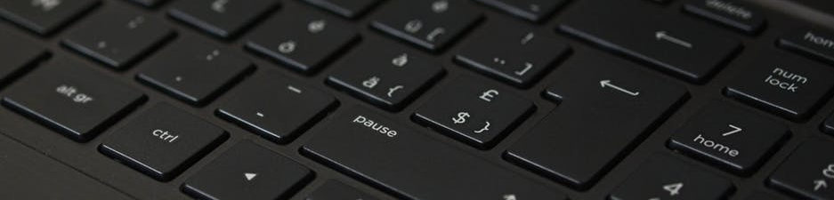

Let’s Make Some Website!!!
You will learn about basics of how internet works and build your own website!
It will be a fascinating journey, so be focused and stay on the track, yay!
by Divisi Komputer
Himpunan Mahasiswa Elektroteknik
Institut Teknologi Bandung

Slide 2
The Story of Internet
How does the Internet work?

Slide 3
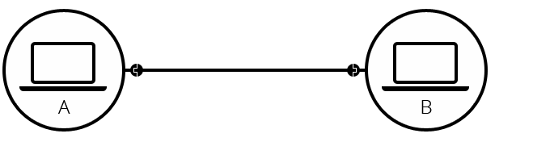
Simple one-to-one Network
Notes:
Komunikasi paling sederhana antar dua computer adalah One-to-One Network. Konektivitas antara keduanya bisa aja pake kabel, wireless, Bluetooth, infrared, suara, cahaya, atau apapun itu selama komunikasi diantara kedua computer bisa terjadi.

Slide 4
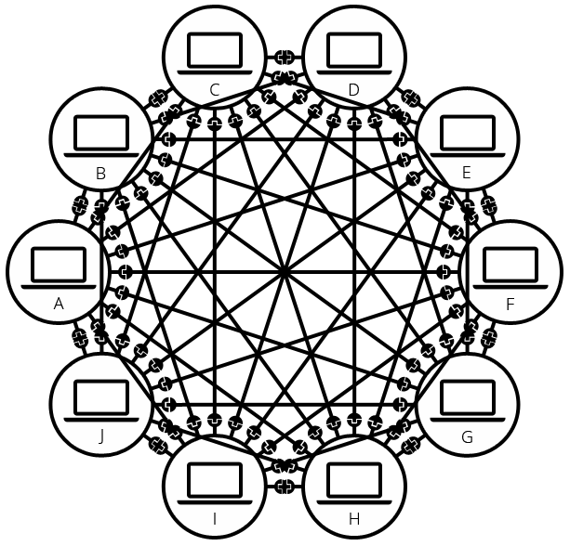
However, what if you want to connect 9 computer?
Notes:
Masalah mulai muncul ketika 9 computer ingin saling terhubung. Wow, kita butuh 45 kabel dengan 9 port untuk setiap computer.

Slide 5
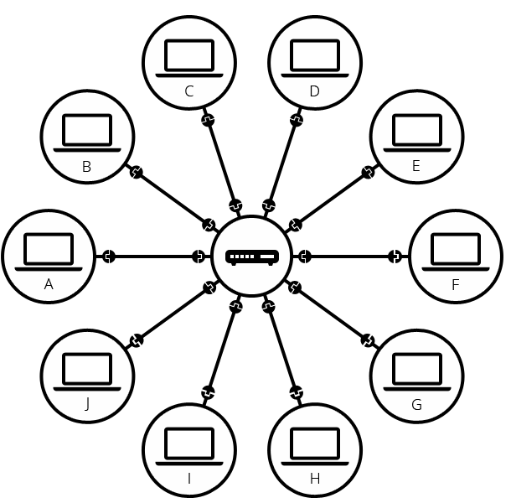
The solution is Router!
Notes:
Yay, router muncul sebagai penyelamat. Router adalah computer kecil yang berfungsi sebagai pengatur arah sinyal. Pekerjaan utamanya adalah memastikan pesan yang dikirim akan sampai ke tujuan yang tepat dan tidak salah kirim. Sekarang, kita hanya butuh 10 kabel deh, 1 port untuk masing-masing computer dan 10 port untuk router kita. Yay, dunia menjadi tempat yang lebih indah!

Slide 6
But, in this world there are more than billion of people!
Notes:
Tapi, problemnya di dunia ini ada lebih dari milyaran orang. Router juga punya batas kesabaran, eh batas port. Kasian kan kalo kebanyakan computer konek ke dia, seberapa pusing apa coba ☹. Bisa aja sih setiap kelompok punya jaringannya masing-masing. Tapi, Kalo orang yang kamu suka ada dijaringan sebelah, gimana cara ngedeketinnya dong? ☹

Slide 7
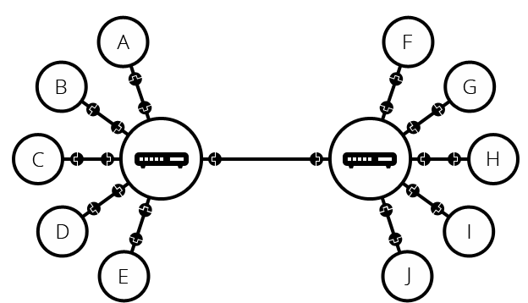
Oops, we forgot that router is also a computer.
Notes:
Oia juga, router kan computer, yauda suruh temenan (konek) aja. Sekarang kamu bias tuh deketin doi via dua router. Cieee.

Slide 8
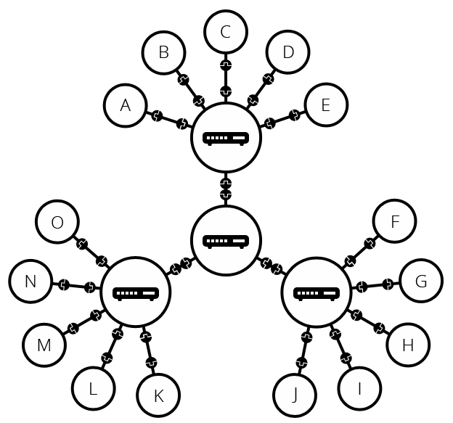
Now, we could scale infinitely!
Notes:
Sekarang, kita bisa scaling hubungan kita ke orang banyak deh! Nah struktur gini tuh uda deket banget sama definisi Internet. Tapi, kita lupa satu hal. Kita bikin jaringan kita untuk tujuan kita sendiri, orang lain juga bikin jaringan untuk tujuan mereka. Tapi, ga mungkin juga kita konekin jaringan kita ke seluruh dunia kan? Butuh kabel berapa panjang coba?

Slide 9
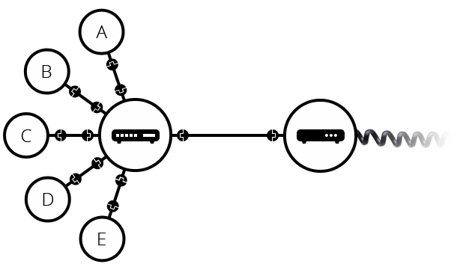
We could use existing technology, Telephone!
Notes:
Nah, dengan memanfaatkan jaringan yang sudah ada sebelumnya. Kita bisa membangun jaringan yang lebih keren lagi. Disini, muncul pahlawan baru bernama Modem. Pahlawan kita ini mengonversi informasi dari jaringan kita menjadi informasi yang dapat dibawa melalui infrastruktur telepon dan sebaliknya.

Slide 10
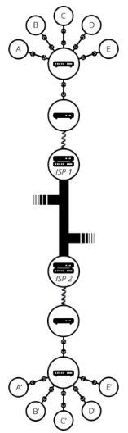
Sending our message to the world!
Notes:
Nah, jaringan telepon kita terkoneksi dengan jaringan luar dengan melalui Internet Service Provider (ISP). ISP adalah perusaan yang mengatur router special yang menghubungkan seluruh dunia dan dapat mengakses router special milik ISP lainnya. Pesan kita dapat melewati jalur ini dan sampai ke tujuan deh!
Sederhananya, Internet teh cuma jaringan begini tapi banyak aja.

Slide 11
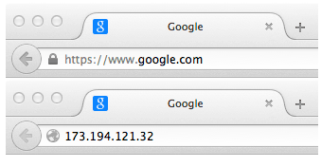
But, how to find our destination?
Notes:
Pesan kita bisa sampai ke computer tujuan lewat sesuatu bernama IP (Internet protocol) address. Biasanya suka ada tuh di pc kalian kaya 192.168.2.10
Misalnya.
Tapi, karena kita manusia. Kita ga suka inget angka, kecuali tanggal ulang tahun doi sama sisa saldo di bank? (eh). Jadi kita bikin alias dari IP address itu namanya Domain Name. Nah, contohnya google.com adalah domain untuk IP address 173.194.121.32 (Contoh ya). Yay kita bias kemana-mana pake nama aja sekarang!

Slide 12
Internet and the Web
Internet is a technical infrastructure which allow billion of computer to be connected together
Web is a service built on top of the Internet. There are also another services that build on top of the Internet such as e-mail and IRC.
Notes:
Jadi, dua hal tersebut beda ya gengs!

Slide 13
The Story of Web
How does the Web work?

Slide 14
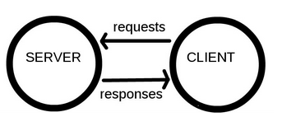
The Simplified Model
Notes:
Komputer yang terhubung ke web, umumnya dimodelkan sebagai klien dan server.
Klien adalah pengguna web umum yang mengakses web menggunakan gawai yang terhubung dengan internet via web browser.
Server adalah computer yang menyimpan halaman web, situs, atau aplikasi. Ketika klien meminta akses ke halaman web, situs, atau aplikasi, server mengirimkan salinannya ke klien agar dapat ditampilkan pada browser klien
Umumnya, model request and response sering digunakan dalam model web.

Slide 15
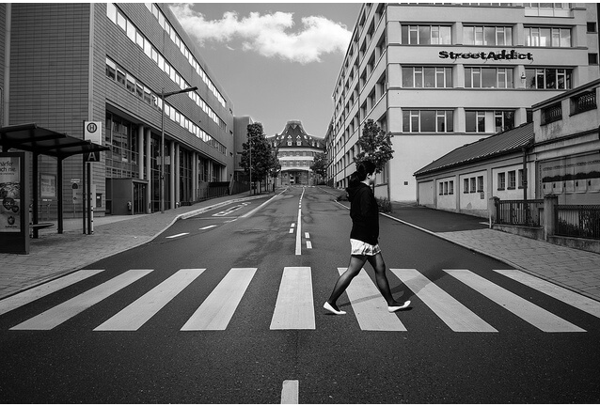
Some analogy to help you understand
Internet
Connection
TCP/IP
DNS
HTTP
Notes:
Bayangkan aja kalo Web adalah sebuah jalan. Kalian adalah klien yang datang dari rumah kalian di sebelah kiri jalan dan toko yang kalian tuju adalah server yang ada di kanan jalan.
Selain kedua hal tersebut, kalian butuh:
Koneksi internet, yang ngasih kalian akses untuk mengirim dan menerima data dari web. Sederhananya semacam zebra cross atau jalan.
TCP/IP, adalah sebuah protocol yang ngasih tau gimana sih cara melakukan sesuatu di web. Contohnya via Mobil, sepeda, atau jalan kaki pasti punya jalur yang beda dan prosedur belanja yang beda (Inget aja McD ada drive thru ada yang ngantri konvensional)
DNS, sederhananya kaya phone book. Mau tau nih McD ada dimana. Nah DNS ngasih alamat jelasnya (IP Address kalo disini)
HTTP, Protokol aplikasi, analoginya Bahasa yang kamu pakai buat mesen di toko tersebut.
Selain itu, ada juga file tambahan kaya kode html css sama js dan asset kaya video, gambar, music.
Selain klien dan server. Kalian harus

Slide 16
So, what’s really happening?
The browser goes to the DNS server, and finds the real address of the server that the website lives on (you find the address of the shop).
The browser sends an HTTP request message to the server, asking it to send a copy of the website to the client (you go to the shop and order your goods). This message, and all other data sent between the client and the server, is sent across your internet connection using TCP/IP.
Provided the server approves the client's request, the server sends the client a "200 OK" message, which means "Of course you can look at that website! Here it is", and then starts sending the website's files to the browser as a series of small chunks called data packets (the shop gives you your goods, and you bring them back to your house).
The browser assembles the small chunks into a complete website and displays it to you (the goods arrive at your door — new shiny stuff, awesome!).
Notes:
Satu-satu jelasinnya wkwk

Slide 17
More about DNS and Packets
DNS or Domain Name Server is invented because we don’t want to remember all those number of every website.
DNS would provide us the IP address of our favourite website. Cool Right?
Packets is a format of sent data from server to client.
When data is sent across the Web, data is sent as small chunk. This will allow many user to use the Web at the same time.
If the data is sent as big chunk, only one user can access the web ☹

Slide 18
The Story of Your First Website
Let’s learn some basic terminology and how web works!
This gonna be fun!
Notes:
Sesi Workshop

Slide 19
Let’s Install the Basic Software
Text Editor
Any editor will suffice (Vim, emac, Visual Studio Code, Notepad++, or even Notepad)
Bracket is also a good one!
Web Browser
Some developer prefer Chrome or Firefox
Install at least two browser for testing purpose!
Local Web Server (optional)
Local web server for serving your website locally
We won’t use this today tho
Notes:
Cukup deskriptif lah ya

Slide 20
Next, plan what will your website look like?
Answer these Question:
What is your website about?
What information are you presenting on the Subject?
What does your website look like?

Slide 21
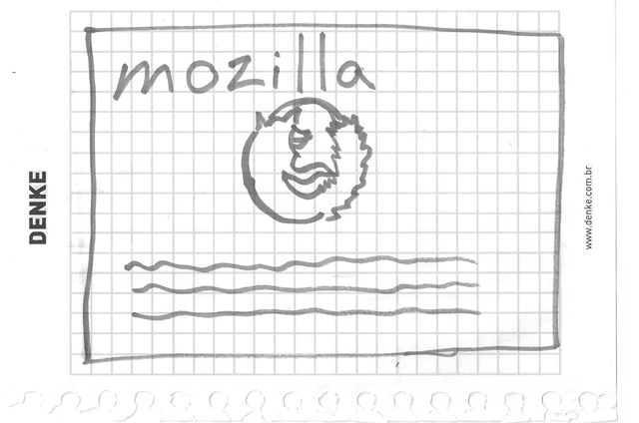
Sketch your website out!
Notes:
Pada proyek besar, umumnya desain sketsa kasar seperti inilah yang kemudian didigitalisasi dan dibuat mockupnya. Tim desain proyek mencakup tim UI dan UX.

Slide 22
Choosing your Assets!
Text
The paragraph and sentences should be as professional as possible.
Make the information as brief as possible, don’t confuse reader!
Theme color
Choosing color is one of web designer job, sometimes it will be hard but the other time it will be easy.
Images
You could search for stock images online. But, becareful with copyright!
Font
The font also decide how your website aestethic and readability, so choose carefully!

Slide 23
Organize the file structure!
Project Folder
Choose a folder to put your projects such as ‘web-project’
Inside the folder, create another folder for your first website ‘test-site’
Casing and Spacing
Use lower case and hypen (-) for the file name because usually the web server is case sensitive. This will reduce the hassle of remembering which letter is upper case (MyFileName.html).
Structure
index.html: Usually this will contain your homepage content
images folder: This will contain all your images for the website
styles folder: This will contain CSS code used to style your content
script folder: This will contain JS code to add some interactive function

Slide 24
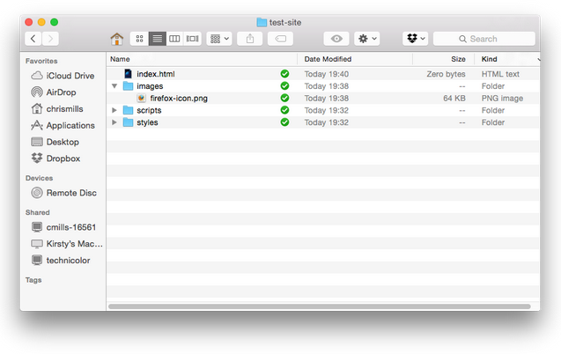
The structure should look like this

Slide 25
HTML The Skeleton of Our Website
Finally, no more story please, let’s get into the real thing!

Slide 26
What is HTML
HTML is not a programming language!
HTML consist of several element that structures your webpage.
For, example we want to display this as one stand line
My cat is very grumpy
In HTML, we could specify the sentence as paragraph by enclosing it in paragraph tags
<p> My cat is very grumpy </p>

Slide 27
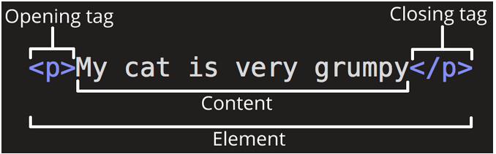
Dissecting the HTML
Notes:
The opening tag: berisi nama elemen, menandakan kapan elemen dimulai (dalam kasus ini paragraph dimulai)
The closing tag: sama dengan opening tag, tapi ditambah forward slash, menandakan kapan elemen berakhir. Biasanya pemula suka lupa kasih closing tag, hasilnya ya jadi lucu.
The content: This is the content of the element, which in this case is just text.
The element: The opening tag, the closing tag, and the content together comprise the element.

Slide 28
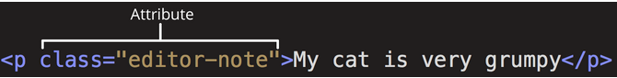
Adding some Attributes
Notes:
Attribute digunakan untuk menyimpan informasi tambahan tentang elemen yang tidak ingin kita tampilkan pada webpage. Dalam kasus ini, class adalah nama attribute, dan editor-note adalah value dari attribute. Attribute dapat digunakan sebagai identifier untuk menargetkan elemen dalam styling nanti

Slide 29
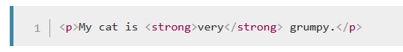
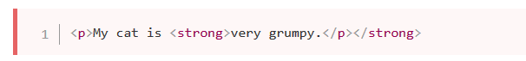
Nesting Attribute
Correct
Incorrect
Notes:
Jangan lupa tagnya harus ngurut nutupnya

Slide 30
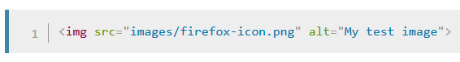
Empty Element
Notes:
Nah, ada juga yang ga punya content, namanya empty element. Biasanya kalo nampilin media kaya image nih. Penjelasan image ada nanti.

Slide 31
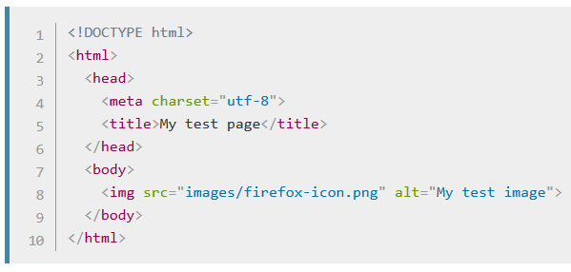
Anatomy of a HTML Document
Notes:
<!DOCTYPE html> — the doctype: Tambahin aja, konvensi lama di HTML. Ada sejarahnya tapi ga penting-penting amat.
<html></html> -- Biasanya disebut root element, seluruh sintaks html kita harus ada di dalam tag ini
<head></head> -- Container dari seluruh element html yang bukan bagian dari konten yang ingin disajikan pada web. Contohnya metadata kaya page description, tag, script, dll
<meta charset="utf-8"> -- Elemen ini ngatur supaya dokumennya pakai konvensi UTF-8. Salah satu konvensi juga. Soalnya kebanyakan karakter sudah include pakai ini.
<title></title> -- Elemen ini ngatur judul halaman
<body></body> -- Elemen ini isinya konten yang pengen disajikan, contohnya tulisan, image, video, dll

Slide 32

Adding some Image
Notes:
Tag ini nampilin image dari src
Pathnya relative terhadap posisi file html ini.
Alt (alternative) adalah tag yang bakal keliatan kalo image dihover atau dibacain buat orang visual impairment screen reader.
Alt text juga bakal muncul kalo imagenya gagal ke load. Jadi, tulis alt text yang cocok yaaa!

Slide 33
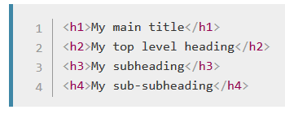
Marking Text: Header
Notes:
Maksimal header 6.

Slide 34
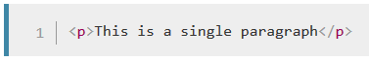
Marking Text: Paragraph

Slide 35
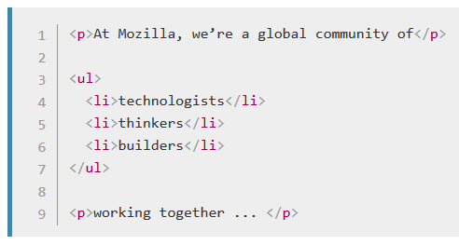
Marking Text: List
Notes:
Ada dua macam list ordered <ol> sama unordered <ul>.

Slide 36
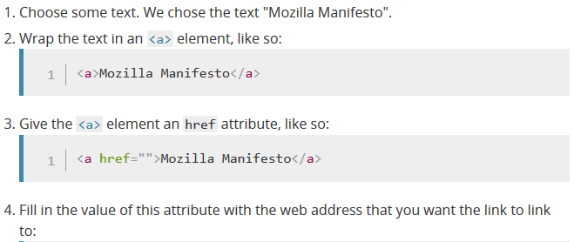
Marking Text: Link
<a href="https://www.mozilla.org/en-US/about/manifesto/">Mozilla Manifesto</a>
Notes:
href = remember that it stands for hypertext reference.
You might get unexpected results if you omit the https:// or http:// part, called the protocol, at the beginning of the web address. After making a link, click it to make sure it is sending you where you wanted it to

Slide 37
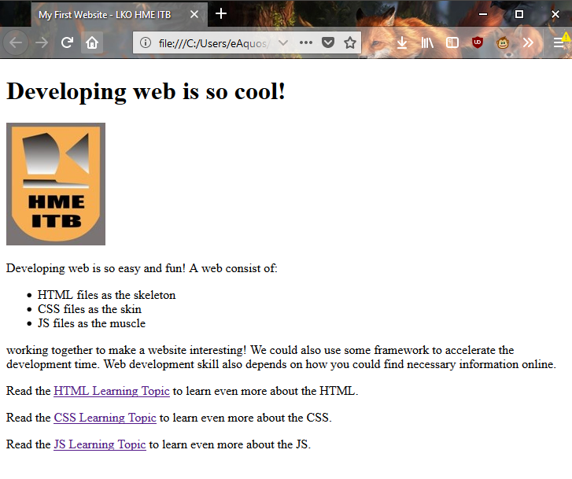
Let’s Build This!
Notes:
href = remember that it stands for hypertext reference.
You might get unexpected results if you omit the https:// or http:// part, called the protocol, at the beginning of the web address. After making a link, click it to make sure it is sending you where you wanted it to

Slide 38
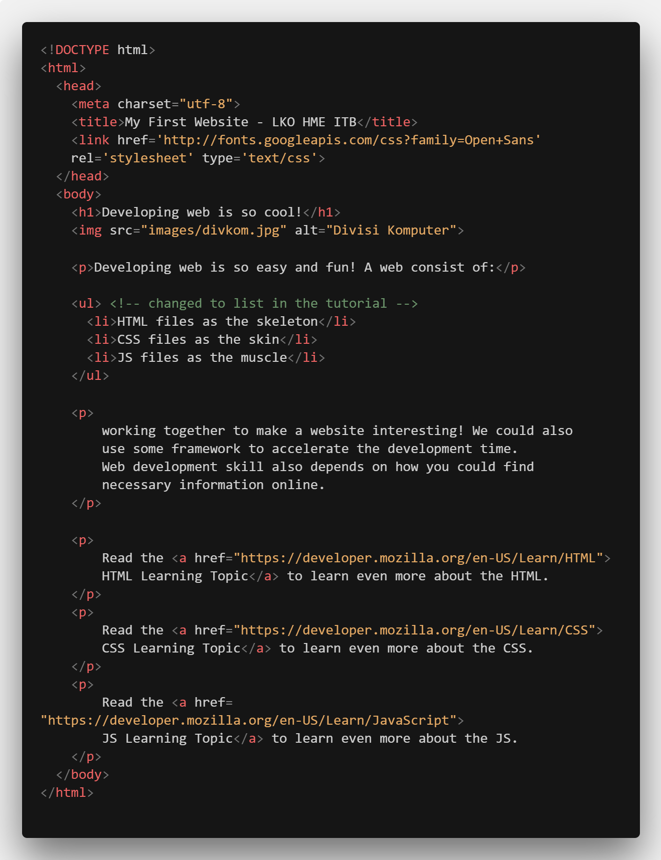
Code Sneek Peek
Notes:
href = remember that it stands for hypertext reference.
You might get unexpected results if you omit the https:// or http:// part, called the protocol, at the beginning of the web address. After making a link, click it to make sure it is sending you where you wanted it to

Slide 39
CSS The Skin of Our Website
Let’s style our Website!

Slide 40
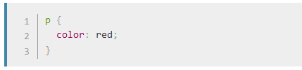
What is CSS
CSS is also not a programming language!
CSS consist of several element that style your website.
For, example we want to display this paragraph as red colored text
<p> My cat is very grumpy </p>
In CSS, we could specify the paragraph by selecting it and apply some style.

Slide 41
What is CSS
After that, save the code into `styles/style.css`
Open your `index.html` and add this line to the <head></head> tag
Save `index.html` and refresh!

Slide 42
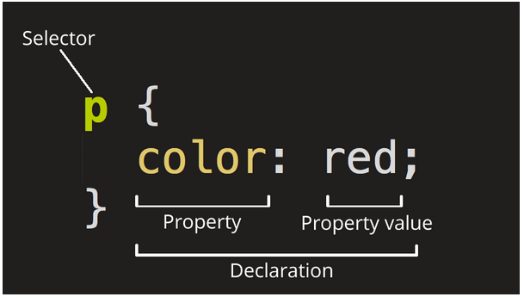
Dissecting the CSS
Notes:
Selector: The HTML element name at the start of the rule set. It selects the element(s) to be styled (in this case, p elements). To style a different element, just change the selector. Declaration: A single rule like color: red; specifying which of the element's properties you want to style.
Properties: Ways in which you can style a given HTML element. (In this case, color is a property of the <p> elements.) In CSS, you choose which properties you want to affect in your rule.
Property value: To the right of the property after the colon, we have the property value, which chooses one out of many possible appearances for a given property (there are many color values besides red).

Slide 43
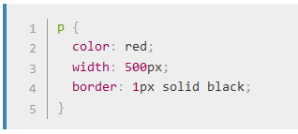
Multiple Rules
Notes:
Also some basic rule:
Each rule set (apart from the selector) must be wrapped in curly braces ({}).
Within each declaration, you must use a colon (:) to separate the property from its values.
Within each rule set, you must use a semicolon (;) to separate each declaration from the next one.

Slide 44
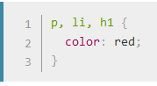
Selecting Multiple Element

Slide 45
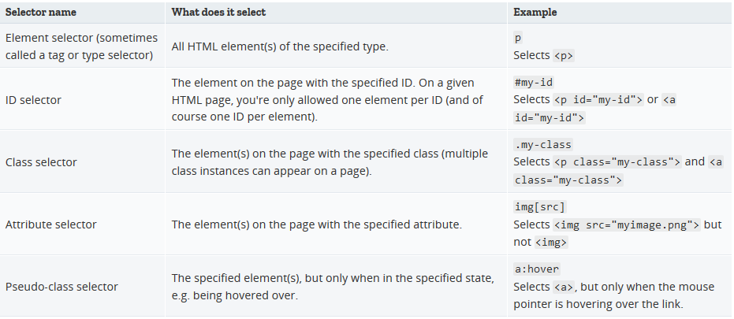
More Selector

Slide 46
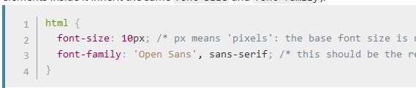
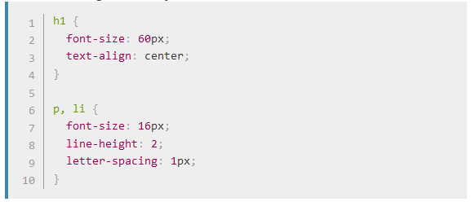
Font and Text
Create new style.css (delete the red paragraph from before)
We will also stylize header and list

Slide 47
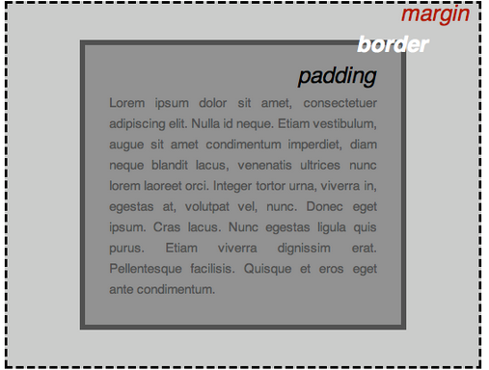
CSS is all about Boxes
Notes:
padding, the space just around the content (e.g., around paragraph text)
border, the solid line that sits just outside the padding
margin, the space around the outside of the element
In this section we also use:
width (of an element)
background-color, the color behind an element's content and padding
color, the color of an element's content (usually text)
text-shadow: sets a drop shadow on the text inside an element
display: sets the display mode of an element (don't worry about this yet)

Slide 48
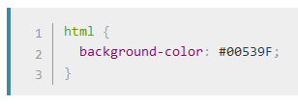
Changing Page Color
Notes:
padding, the space just around the content (e.g., around paragraph text)
border, the solid line that sits just outside the padding
margin, the space around the outside of the element

Slide 49
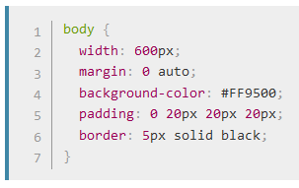
Sorting the Body Out
Notes:
width: 600px; — this forces the body to always be 600 pixels wide.
margin: 0 auto; — When you set two values on a property like margin or padding, the first value affects the element's top and bottom side (make it 0 in this case), and the second value the left and right side (here, auto is a special value that divides the available horizontal space evenly between left and right). You can also use one, three, or four values, as documented here.
background-color: #FF9500; — as before, this sets the element's background color. We've used a sort of reddish orange for the body as opposed to dark blue for the <html> element, but feel free to go ahead and experiment.
padding: 0 20px 20px 20px; — we have four values set on the padding, to make a bit of space around our content. This time we are setting no padding on the top of the body, and 20 pixels on the left, bottom and right. The values set top, right, bottom, left, in that order.
border: 5px solid black; — this simply sets a 5-pixel–wide, solid black border on all sides of the body.

Slide 50
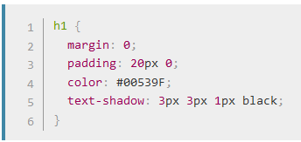
Positioning and Styling our Title
Notes:
To get rid of the top gap of H1 we overrode the default styling by setting margin: 0;.
Next up, we've set the heading's top and bottom padding to 20 pixels, and made the heading text the same color as the html background color.
Text Shadow:
The first pixel value sets the horizontal offset of the shadow from the text — how far it moves across: a negative value should move it to the left.
The second pixel value sets the vertical offset of the shadow from the text — how far it moves down, in this example; a negative value should move it up.
The third pixel value sets the blur radius of the shadow — a bigger value will mean a more blurry shadow.
The fourth value sets the base color of the shadow.

Slide 51
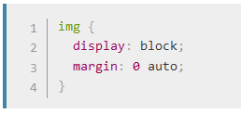
Centering the Image
Notes:
We could use the margin: 0 auto trick again as we did earlier for the body, but we also need to do something else. The <body> element is block level, meaning it takes up space on the page and can have margin and other spacing values applied to it. Images, on the other hand, are inline elements, meaning they can't. So to apply margins to the image, we have to give the image block-level behavior using display: block;.

Slide 52
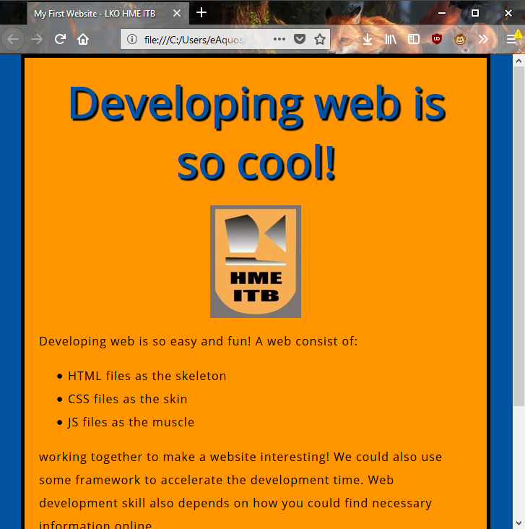
Let’s Build This!
Notes:
href = remember that it stands for hypertext reference.
You might get unexpected results if you omit the https:// or http:// part, called the protocol, at the beginning of the web address. After making a link, click it to make sure it is sending you where you wanted it to

Slide 53
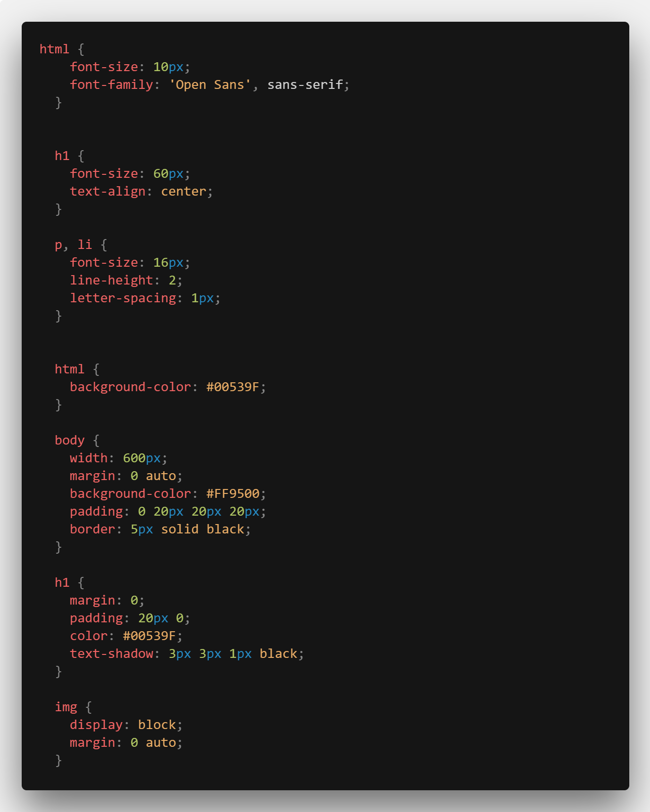
Code Sneek Peek
Notes:
href = remember that it stands for hypertext reference.
You might get unexpected results if you omit the https:// or http:// part, called the protocol, at the beginning of the web address. After making a link, click it to make sure it is sending you where you wanted it to

Slide 54
JavaScript The Muscle of Our Website
Let’s make our website more dynamic and Interactive!

Slide 55
What is JavaScript
JavaScript (JS) is a full-fledged dynamic programming language that, when applied to an HTML document, can provide dynamic interactivity on websites.
JavaScript is incredibly versatile. You can start small, with carousels, image galleries, fluctuating layouts, and responses to button clicks.
With more experience, you'll be able to create games, animated 2D and 3D graphics, comprehensive database-driven apps, and much more!

Slide 56
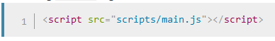
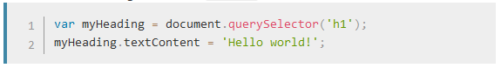
The infamous “Hello World”
Create new file `scripts/main.js`
Inside `index.html` add this line just before </body> tag
Now, add this code into `main.js`
Then refresh and see what happened!

Slide 57
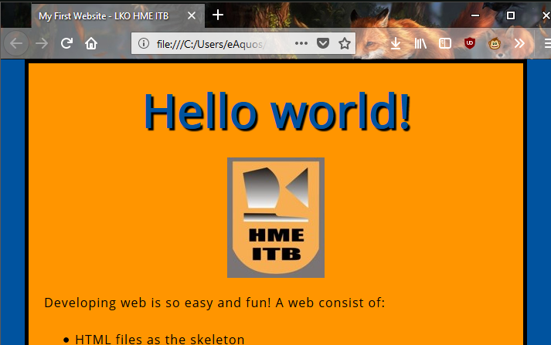
The infamous “Hello World”
Notes:
Nah, bisa dilihat kalo pas direfresh cepat, judulnya berubah. Hal ini nunjukin kalo script pada web bagusnya ditaro di akhir body karena bisa memperlambat loading page dari web.
Selain itu, bisa jadi juga kalau scriptnya ditaro diatas, ga semua elemen kena efek script yang sama. Ga reliable jadinya.

Slide 58
The infamous “Hello World”

Slide 59
Do you wonder what we did?
Notes:
You did this by first using a function called querySelector() to grab a reference to your heading, and store it in a variable called myHeading.
This is very similar to what we did using CSS selectors. When wanting to do something to an element, you first need to select it.
After that, you set the value of the myHeading variable's textContent property (which represents the content of the heading) to "Hello world!".
Ini bisa terjadi karena kita tau ada yang namanya Document Object Model. Kita tinggal pake aja.
More about this: https://developer.mozilla.org/en-US/docs/Web/API/Document_Object_Model

Slide 60
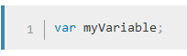
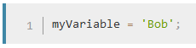
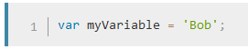
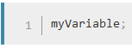
JS Crash Course: Variable
Declaring Variable
Defining Variable
Both at the same line
Accessing Variable
Notes:
A semicolon at the end of a line indicates where a statement ends; it is only absolutely required when you need to separate statements on a single line. However, some people believe that it is a good practice to put them in at the end of each statement. There are other rules for when you should and shouldn't use them — see Your Guide to Semicolons in JavaScript for more details.
You can name a variable nearly anything, but there are some name restrictions (see this article on variable naming rules). If you are unsure, you can check your variable name to see if it is valid.
JavaScript is case sensitive — myVariable is a different variable to myvariable. If you are getting problems in your code, check the casing!

Slide 61
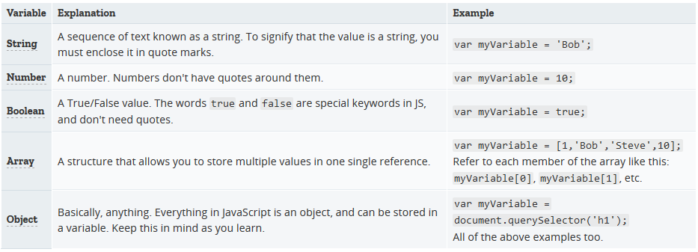
JS Crash Course: Variable

Slide 62
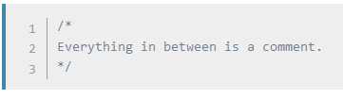
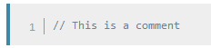
JS Crash Course: Comment

Slide 63
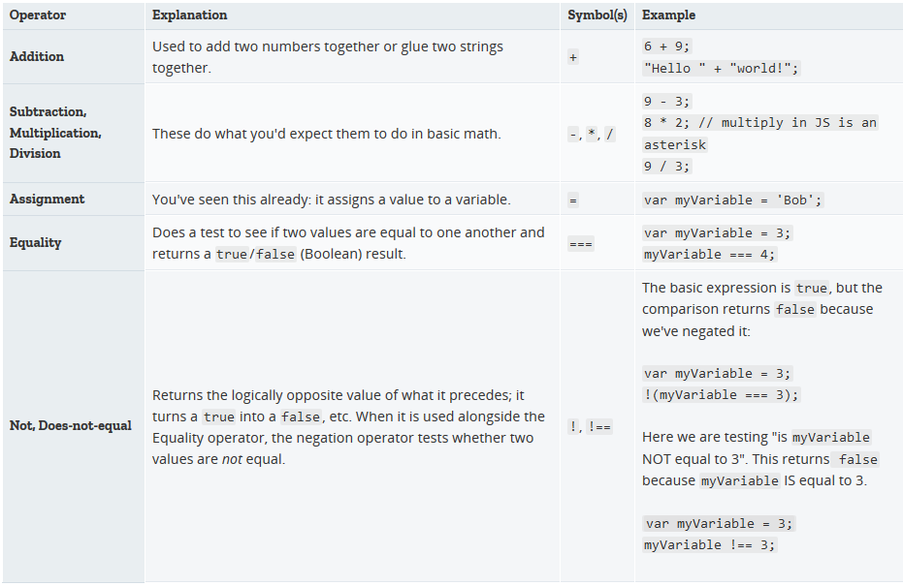
JS Crash Course: Operator

Slide 64

JS Crash Course: Conditional

Slide 65


JS Crash Course: Function

Slide 66


JS Crash Course: Events
Notes:
Real interactivity on a website needs events. These are code structures which listen for things happening in browser, running code in response. The most obvious example is the click event, which is fired by the browser when you click on something with your mouse. To demonstrate this, enter the following into your console, then click on the current webpage:

Slide 67

Change the Image
Notes:
You store a reference to your <img> element in the myImage variable. Next, you make this variable's onclick event handler property equal to a function with no name (an "anonymous" function). Now, every time this element is clicked:
You retrieve the value of the image's src attribute.
You use a conditional to check whether the src value is equal to the path to the original image:
If it is, you change the src value to the path to the 2nd image, forcing the other image to be loaded inside the <img> element.
If it isn't (meaning it must already have changed), the src value swaps back to the original image path, to the original state.

Slide 68


Change the Image
Notes:
Real interactivity on a website needs events. These are code structures which listen for things happening in browser, running code in response. The most obvious example is the click event, which is fired by the browser when you click on something with your mouse. To demonstrate this, enter the following into your console, then click on the current webpage:

Slide 69



Personalized Welcome Message
Add a button at the bottom of the html page by adding this line
In `main.js` add this line of code to select our element
Now, we create some function
Notes:
This function contains a prompt() function, which brings up a dialog box, a bit like alert(). This prompt(), however, asks the user to enter some data, storing it in a variable after the user presses OK. In this case, we are asking the user to enter their name. Next, we call on an API called localStorage, which allows us to store data in the browser and later retrieve it. We use localStorage's setItem() function to create and store a data item called 'name', setting its value to the myName variable which contains the data the user entered. Finally, we set the textContent of the heading to a string, plus the user's newly stored name.

Slide 70


Personalized Welcome Message
Now, we make some initialization code
Last, put below onclick event handler on the button to set new name!
Notes:
This block first uses the negation operator (logical NOT, represented by the !) to check whether the name data exists. If not, the setUserName() function is run to create it. If it exists (that is, the user set it during a previous visit), we retrieve the stored name using getItem() and set the textContent of the heading to a string, plus the user's name, as we did inside setUserName().

Slide 71

Personalized Welcome Message

Slide 72

Personalized Welcome Message

Slide 73

Personalized Welcome Message

Slide 74

Personalized Welcome Message

Slide 75

More Resource

Slide 76

More Resource

Slide 77

More Resource

Slide 78
More Resource
Audio Visual Resources:
There and Back Again: A Packet's Tale
How Internet Works in 5 minutes
Web Demystified
Web Development tutorial for Beginners
Futher Readings (If you like Reading more!):
How does the Internet Works by MDN
Getting started with the Web by MDN
Learn HTML Pathway by MDN
Learn CSS Pathway by MDN
Learn JS Pathway by MDN

Slide 79
The End of Our Journey
Thank you for all your attention! Probably all of this is very comprehensive and tiring to follow. But, worry not because you can review the code later!
This is the introduction to the Front-end Web Development. But, only using this knowledge and a little more effort you can build professional Website in no time! Cool isn’t it?
Building website is simple, the most complex part of building a website is solving real problem. Don’t let creativity dies inside your head! After all what you need is only text editor, internet connection, and some drinks!

